Slide 1

Agile Functional
Test Automation
Linda Hayes
CTO
Worksoft, Inc.

Slide 2
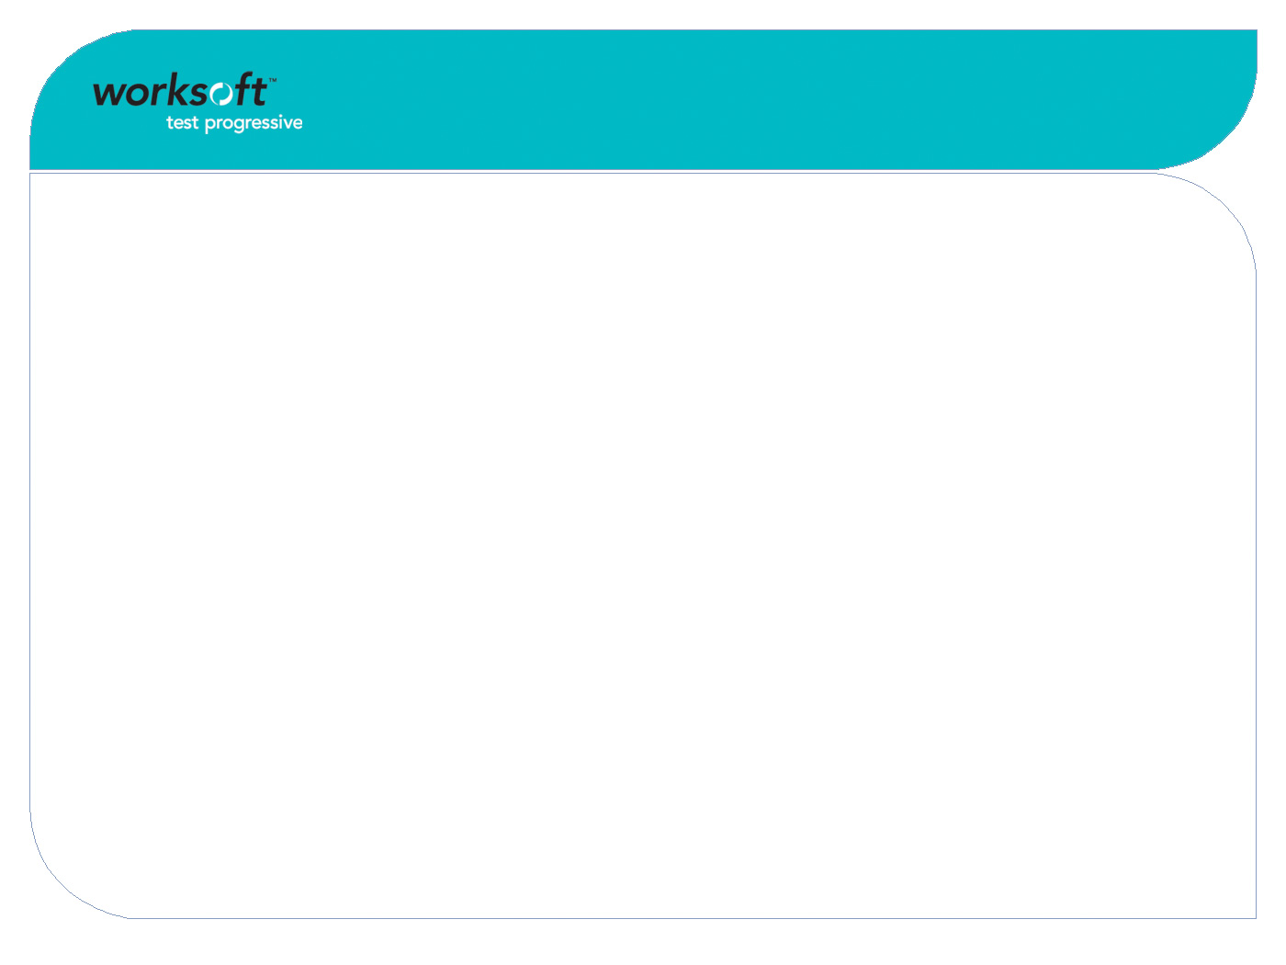

Agenda
Agile Development Overview
  What are the principles, types and challenges of agile development?
Agile Functional Testing Objectives
  What are benefits of agile functional test automation?
Agile Automation Challenges
  What are obstacles to automation of agile testing?
Agile Functional Automation Approach
  How can agile functional testing be automated?

Slide 3

Principles of Agile Development
Highly interactive, informal
  People-driven instead of process-driven
Cross-functional teams
  All stakeholders involved all the time
Built in business order
  Priorities set by users
Short, fixed cycle times
  Variable content
Change-friendly process
  Adaptive instead of predictive

Slide 4

Types of Agile Development
Extreme Programming (XP)
  Typical 1-2 week iterations
Scrum
  Typical 1 month “sprints”
Crystal
  Flexible iterations
Others…
  RAD – rapid application development
  Spiral
  Staged
  Incremental

Slide 5

Agile Development Challenges
Informality means less documentation
  How are requirements to be captured and managed for the long term?
Functionality is cumulative but iterations are fixed
  Test coverage has to keep up
Short release schedules compress testing
  10% incremental functionality still means 100% testing
Changes create maintenance
  Test assets have to keep up
  Regression of prior iterations
  Test new iteration

Slide 6

Agile Automation Objectives…
Executable requirements
  Express requirements as tests
Enable automated testability
  Improve code development practices
Minimize cycle time
  Tests are ready when code is
Reduce rework
  Tests clarify requirements
Improve quality
  Cumulative test coverage
Capture and transfer knowledge
  Test assets survive turnover

Slide 7

Executable Requirements
Remove ambiguity
  Not just what it should do but how it should do it
  Requires explicit criteria and data
Introduce objectivity
  Tests either pass or fail
  Avoid debates about what was expected
Standardize format
  Automation demands structure and detail
  Improve maintainability, transferability
Move earlier in cycle
  Provide guidance to developers
  Support unit testing

Slide 8

Enable Automated Testability
Assure automation compatibility
  Identify obstacles to automation early
  Modify code practices as needed
Assure test repeatability
  Can be re-executed on later iterations
  Supports regression testing
Minimize test maintenance
  Make tests readable
  Reduce impact of changes

Slide 9

Rapid Coding
Aggressive schedules
  Short iterations
  Rich, complex applications
Rapidly add functionality
  Third party components
  Use of code generators
  Transient code, regenerated each build
Introduces automation issues
  Dynamic layouts
  Anonymous objects
  Inaccessible controls
  Tests not maintainable, reliable

Slide 10

Dynamic Layouts
Based on database contents
  Content of lists
  Items will change positions
Based on user interaction
  Selected options control format
  Sequence of events alters workflow
No concept of context
  Title may not be useful or unique
  May use single page or window for entire application
Impairs context verification
  Cannot verify workflow
  Cannot verify object inventory

Slide 11

Anonymous Objects
Some have no name at all
  May be formatting only or may contain critical data
  Cannot be understood
    Example: VT-008-TBBN
IDs or names are not unique
  Different objects use same ID or name within page
  Violation of coding rules but permitted
IDs or names are not persistent
  ID or name changes within or between releases
Tests are not reliable, repeatable
  Cannot find or verify objects

Slide 12

Inaccessible Controls
Containers mask contents
  Execution shells
  Embedded browsers
  Objects within objects
  Example: Combo box within table
Custom objects
  Not a standard class
  Unknown methods, properties
  Example: table, tree view
Private methods, properties
  Attribute set by developer
  Not accessible from outside

Slide 13

Tests Not Maintainable, Reliable
Constant state of flux
  Nothing to anchor to
  Is this the same object as before?
  Have to re-map entire application for each release
  Time-consuming, opportunity for error
Low reliability
  Easy to get out of context
  Am I in the right place?
  Difficult to verify critical data
  Where is it located?
High overhead
  Constant maintenance
  Underlying code is moving target

Slide 14

Enforce Coding Standards
Names are not optional
  Every page, window or context is named
  Every relevant object has a name
Names are usable
  Meaningful: can be understood
  Unique: only one occurrence per context
  Persistent: stable across changes
Enforce concept of context
  Context is a known set of objects
Component accessibility
  Customize classes only as needed
    Maintain standard class interfaces
  Expose UI control methods, properties to execute user actions
    Example: get text, set text
  If container, expose inside access

Slide 15

Verify Conformance Early
Get sample of class library
  One instance of each control type
Verify compatibility
  Class is recognized
  Methods are exposed
  Properties are exposed
Discuss issues with developers
  Change implementation
  Change class library
  Change test tool
Educate management
  ROI of automation
  Impact of maintenance

Slide 16



Minimize Cycle Time
Delivery cycle times are fixed
  Only functionality is variable
  Testing has to keep up
Each release is incremental
  Development adds 10%
  Testing requires 100%
Automation is only practical solution
  Tests keep pace with features
  Unattended execution
Features
Tests
Risk
#
Time

Slide 17

Agile Automation Challenges
Short cycle time
  Rapid iterations compress test time
High rate of change
  Iterative development means constant modifications
Automated tests require maintenance
  Keep pace with changes
Too late in cycle
  Doesn’t support developers

Slide 18

Record/Play Not An Option
Can’t record until software is functional
  Testing starts too late
High volume due to embedded data
  Lots of redundancy
  Small changes have wide impact
Unstable, unreliable execution
  No logic to handle timing, recovery from errors
High maintenance costs
  No structure
  Poor or no documentation

Slide 19

Scripting Too Time-Consuming
Requires coding skills
  Creates two-step, two-skill process
Steep learning curve
  Tools often proprietary languages
Lengthy development effort
  Can take 10X manual test effort
High maintenance costs
  Code volume can exceed application

Slide 20

Objectives of Agile Automation…
Start early
  Plan ahead
Create reusable framework
  Minimize coding effort
Build tests as data
  Shield analysts from coding
Develop tests concurrently
  Ready to execute when code is
Reduce maintenance overhead
  Maintain data, not code

Slide 21

Start Early
Assemble project team
  Business experts
  Automation engineers
  Software developers
Assign roles and responsibilities
  Identify tasks, skills
  Assign to team members
Establish ground rules
  Length of iteration
  Format of test cases
  Naming conventions
  Test environment

Slide 22

Create Reusable Framework
Build or buy decision
  Research commercial solutions
  Evaluate compatibility
  Assess time, cost, effort
Develop infrastructure
  Test case format
  Reusable components
Utilities to manage execution
  Setup test environment
  Recover context
  Log errors
  Log tests

Slide 23

Build Tests As Data
Avoid writing tests as code
  Requires coding skills
  Results in custom code
  Must be developed, supported, maintained
  Difficult to transfer
Store tests as data
  Removes need for technical skills to write tests
  Simplify and standardize format
  Support impact analysis
  Enable global updates

Slide 24

Develop Tests Concurrently
Convert stories to test cases
  Executable requirements
Develop in layers
  Add detail as information becomes available
Provide data early
  Support debugging
Establish naming conventions early
  Support future maintenance
Separate data from code
  Minimize coding, maintenance

Slide 25

Reduce Maintenance Overhead
High rate of change
  Incremental functionality adds new features
  Each iteration could change prior functionality
Short iterations compress time
  Must test new features
  May need to update prior tests
Tests stored as code are hard to maintain
  Must manually locate areas of impact
  Must manually make changes and debug
Tests stored in database are easier to maintain
  Database maintains relationships
  Impact is automated
  Changes can be automated

Slide 26

Agile Team
Business experts
  Source of stories (requirements), workflows
  Provide priorities
  Perform functional testing
Automation engineers
  Develop automation infrastructure
  Develop, maintain automation map
Software developers
  Write application code
  Perform unit testing

Slide 27
Project Timeline
Project
Planning
First Iteration
Second Iteration
Business Expert
Environment
Conventions
Stories
Test
Data
Work
Flow
Execution
Stories
Test
Data
Work
Flow
Execution
Second Iteration
Software Developer
Platform
Toolkit
Sample
Objects
Design
Code
Unit
Test
Design
Code
Unit
Test
Automation Engineer
Second Iteration
Tool
Class/Actions
Repository
Map
Variables
Utilities
Map
Variables
Impact Analysis
Updates

Slide 28
Project
Planning Phase

Slide 29

Business Expert
Define test environment
  Dedicated test platform
  Defined hardware
  Controlled software, data
Develop data strategy
  Clean start and add data
  Extract from production and search
  Seed existing data
  Archive and restore
Establish naming conventions
  Data elements
  Windows
  Objects
  Test cases
  Test data sets

Slide 30

Software Developer
Identify platform
  Thin client or thick client
  Services, transports
  Databases, files, interfaces
Select development toolkit
  Programming language
  Class library, components
Adopt naming conventions
  Windows, objects
Adopt coding conventions
  Classes, methods, properties
Develop sample objects
  Used to test automation compatibility

Slide 31

Automation Engineer
Select automation tool(s)
  Buy or Build
  Drive UI
  Drive services
  Interact with database
Implement class/actions
  Inventory of classes
  Matrix of classes and related actions
  Test against sample objects
  Identify and resolve incompatibilities
Utilities to manage execution
  Setup test environment
  Drivers to package tests
  Recover context
  Log errors, tests

Slide 32

Automation Engineer
Implement test repository
  Excel
    Widely available
    Common skill
    Difficult to control, share
    Difficult to enforce conventions
    Easy to make errors
  Database
    May require licensing
    Requires DBA skills
    Easier to control and share
    Prevent or reduce errors
  Commercial
    Will require licensing
    DBA skills may not be required
    May provide permissions, security model to manage access

Slide 33

Buy or Build
Tool already available in house?
  Investigate for compatibility
Class library supported?
  Look for custom controls
Engineering skills available?
  Need proficiency in script language
Project time allocated?
  Estimate development effort
Ongoing support available?
  Assets will survive project

Slide 34

Class
Type of application component
  Class determines characteristics
  Methods are available actions
  Properties are available information
Example Classes
  Edit box, check box, list box, push button, radio button
  May be standard or custom
Methods
  Actions on object: Get text, set row
  May be public or private
Properties
  Information contained about object
  Text value, color, enabled/disabled

Slide 35

Action
Action against object class
  Single function for all instances
  May have multiple parameters
  Single point maintenance
Reusable across applications
  Generic design
  Variables passed from data
Executes step
  Script commands
  Logic and error handling

Slide 36
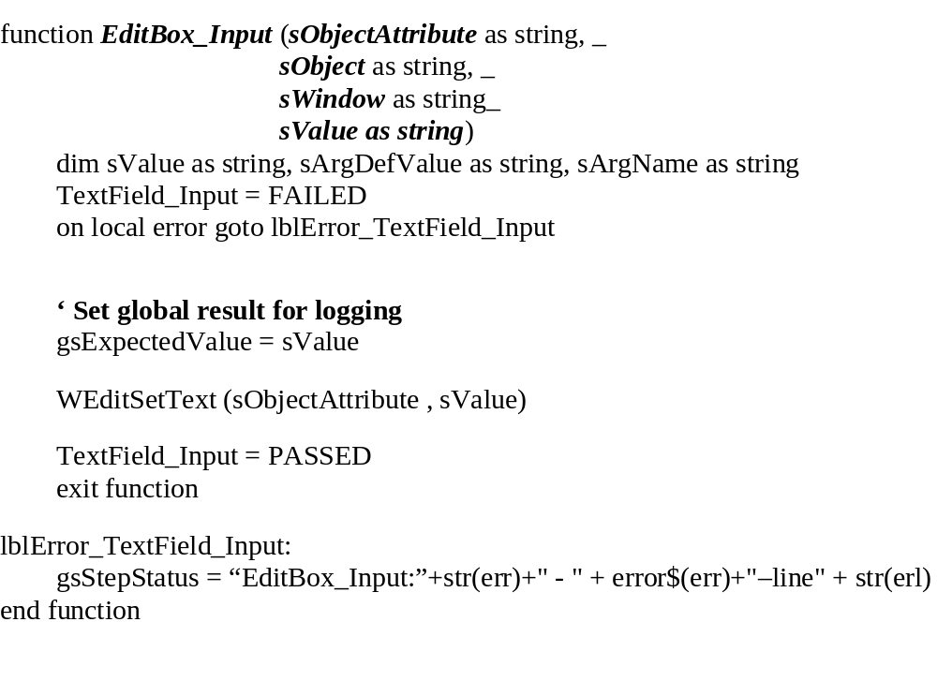
Example Action

Slide 37
Class/Action Matrix
Text Box
  Input
  Verify (EQ,NE,GT,LT,Blank)
  Store in variable
List Box or Radio
  Exists
  Select
  Is Selected
Combo Box
  Select
  Input
  Is Selected
Push Button
  Push
  Is Enabled (Y/N)
Check Box
  Check On/Off
  Is Checked On/Off
Data Grid
  Select Row (First, Last, New, Next, Value)
  Select Column
  Input Cell
  Verify Cell
  Store Cell in variable
  Delete Row
  Delete Column

Slide 38
Generic Actions – All Classes
Is Visible – Yes or No
  Are object properties set to visible
Is Enabled – Yes or No
  Is object available for focus
Click – Left, Right, Double
  Send mouse click to object
Press Keys
  List of function keys to press on object
  Enter, tab, cursor up, down, left, right, etc.

Slide 39
Write Recover
Set of options based on execution results
  On pass
  On fail
May include options to:
  Exit current test, establish context and continue
  Skip current test data record and read next
  Exit current suite
  Skip steps
  Jump to step
  Execute another workflow

Slide 40
Write Error Logging
Called when step fails
  Context incorrect
  Object not available
  Action cannot execute
  Result not expected
Documents result
  Capture screen
  Log test status
    Workflow
    Test data row
    Context
    Object
    Action
    Actual, expected result

Slide 41
Write Test Logging
Called after each step, workflow and suite
  Pass or fail
  Actual and expected results
  Screen capture
  Elapsed time
Saved to database
  Document results
  Provide audit trail
  Support regulatory compliance

Slide 42
Write Suite Driver
Used to organize tests into suites
  May be multiple levels
Verifies starting and ending state
  Manage context to start test
Executes each test in sequence
  Provide batch testing
Calls error recovery if needed
  Reposition context if lost

Slide 43
Sample Suite Driver
Starting state?
If not, execute Recover
Open Suite file
Read Workflow, Test Data file name until end of file
Execute Workflow driver
End of file

Slide 44
First Iteration

Slide 45

Business Expert
Define Stories/Requirements
  Story: Customers can trade mutual funds online
Identify data elements
  Define data rules
  Define business rules
Develop test data
  Input and output values
Define workflow steps
  Pages, windows or screens
  Fields or objects
  Actions
  On pass/On fail options
Execute tests
  Analyze results

Slide 46
Identify Data Elements
What data is user-supplied?
  Data entry values
  Customer number, fund symbol, # shares, $ amount
What data is retrieved?
  Databases, files, interfaces
  Customer name, fund name, price per share, trade date, load fee rate
What data is calculated or generated?
  Displayed or written out
  Load fee amount, total trade amount

Slide 47
Define Data Rules
Data rules apply to single data element
  No external references
Customer number
  10 digits, numeric integer
  Cannot be negative
Fund symbol
  5 characters, alpha only
Trade date
  MM/DD/YYYY
  Must be today’s date
Trade Type
  Shares or dollars
# Shares
  15 digits, numeric, integer
  Cannot be negative
Price per share
  10 digits, numeric, 2
  Cannot be negative
$ Amount
  18 digits, numeric, 2 decimals
  Cannot be negative
Load fee rate
  4 digits, numeric, 3 decimals
  Cannot be negative

Slide 48
Define Business Rules
Business rules apply to multiple data elements
  Includes external references
Customer number
  Must exist in customer database
Fund symbol
  Must exist in fund database
# Shares
  Cannot exceed total shares issued for fund
Price per share
  Fund value/# shares issued
$ Amount
  Cannot exceed available funds in customer account
Load Fee
  Added to trade total, only applies to designated funds

Slide 49
Define Test Data
One row per rule
  Provide input values
  Specify expected output values
Valid and invalid cases
  Designate each type
Values must be explicit
  No “correct” or “valid” descriptions
Align with expected sources
    Databases
    Files
    Interfaces
Provide to developers early
  Support unit testing

Slide 50
Develop Test Data
Rule | Type | Customer Number | Customer Name | Fund Symbol | Fund Name | Trade Type | $ Amount | # Shares | Trade Total
$ Amount No load | Valid | 1001 | Warren Buffett | GRWTH | Growth | $ Amount | 5000 | ^ | 5115
# Shares No Load | Valid | 2002 | Bill Gates | SWRE | Software | # Shares | ^ | 1000 | 10215
Alpha Customer | Invalid | 3XX3 | George Soros | SHIP | Shipping | $ Amount | 10000 | ^ | 10765
Wrong Fund | Invalid | 4004 | Steve Allen | XXXX | Money Market | # Shares | ^ | 7500 | 7515

Slide 51

Skip Character
Used to skip step
  Leave default value
  Object not always enabled
Select unused symbol or character
  Special treatment during execution
  Blank is ambiguous
  Example: ^

Slide 52
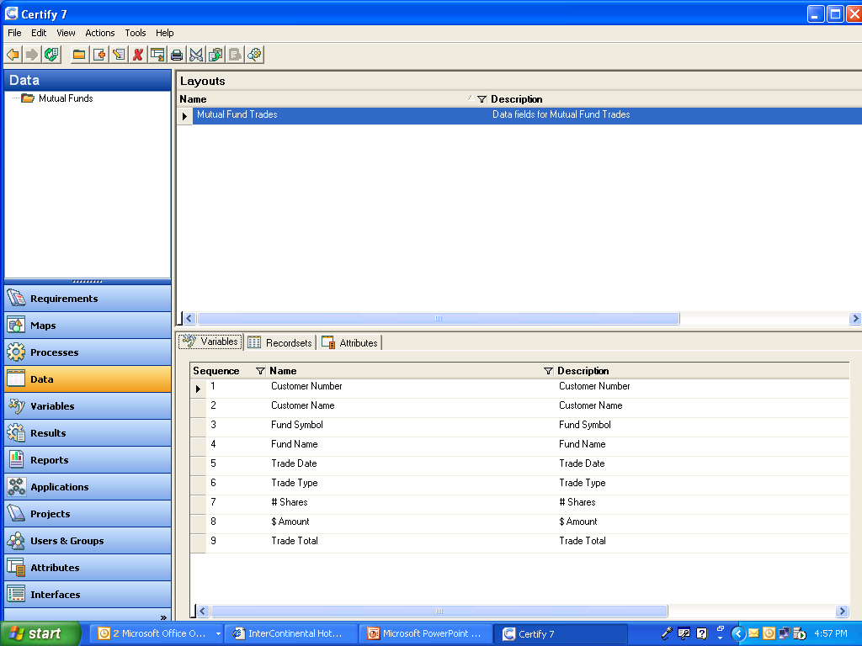
Define Data Layouts

Slide 53
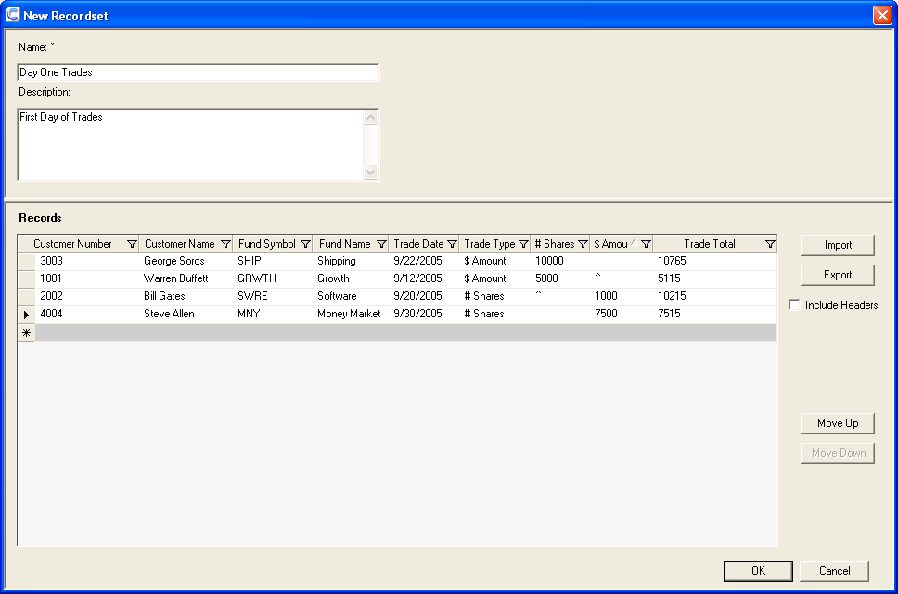
Define Test Data

Slide 54
Define Workflow
Sequence of steps
Logon to application (from previous iteration)
  User ID and password
Select Customer Number
  Verify customer name
Select Fund Symbol
  Verify fund name
Verify trade date
  Must be today
Select type of trade: Shares or Dollars
Enter # of shares or $ amount
Verify trade total (calculated)

Slide 55

Steps
Individual action against object
  Action depends on object class
  Input of data, key(s), mouse event
  Verification of state or data results
  May require one or more parameters
Logs results
  Pass or fail
Handles recovery
  Continue, branch or abort

Slide 56
Define Workflow Steps
Window | Object | Action | Data | Pass | Fail
Enter Trade | Customer Number | Input | @Customer Number | Continue | Stop
Enter Trade | Customer Name | Verify | @Customer Name | Continue | Continue
Enter Trade | Fund Symbol | Select | @Fund Symbol | Continue | Stop
Enter Trade | Fund Name | Verify | @Fund Name | Continue | Continue
Enter Trade | Trade Date | Verify | @System Date | Continue | Continue
Enter Trade | Trade Type | Select | @Trade Type | Continue | Continue
Enter Trade | $ Amount | Input | @Amount | Continue | Continue
Enter Trade | # Shares | Input | @Shares | Continue | Continue
Enter Trade | Trade Total | Verify | @Trade Total | Continue | Continue
Enter Trade | OK | Press |  | Continue | Continue

Slide 57
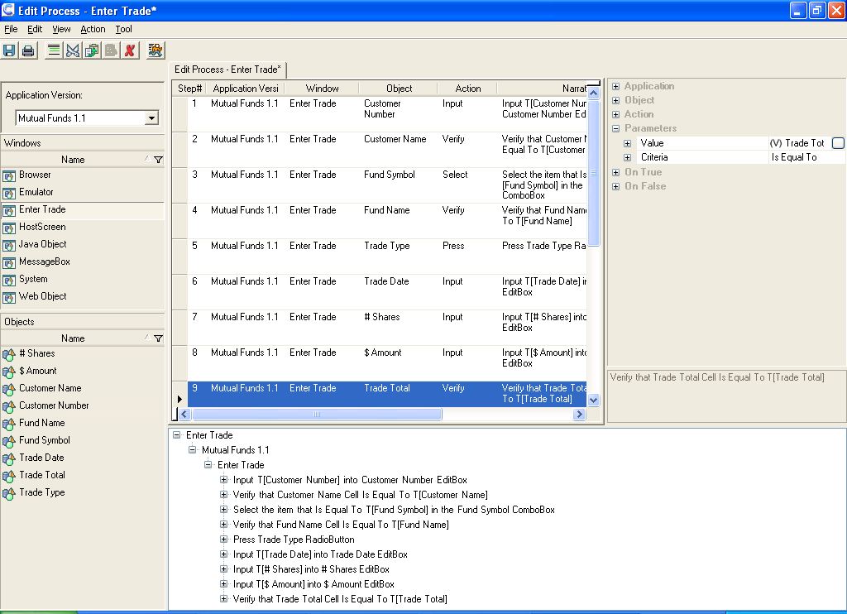
Describe Workflow

Slide 58
Select Window

Slide 59
Select Object

Slide 60
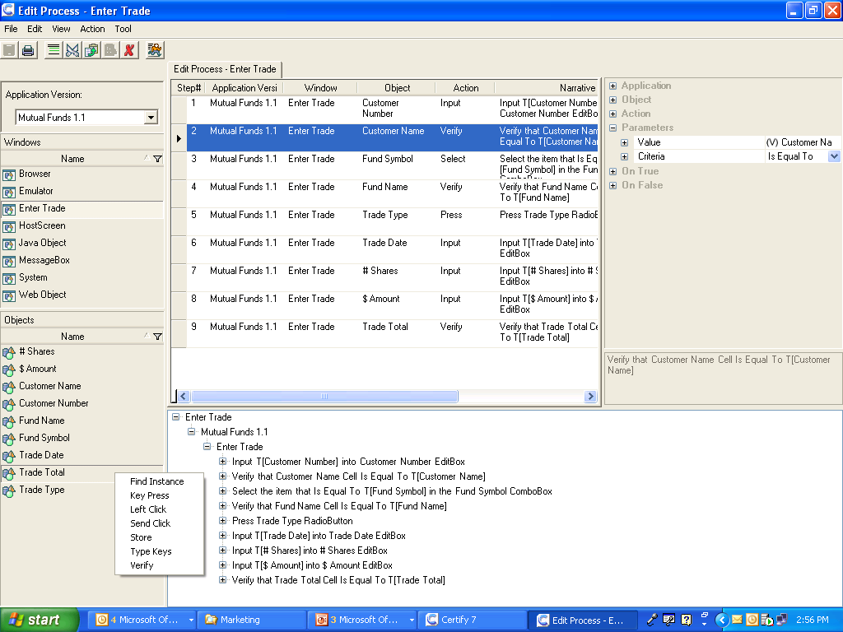
Select Action

Slide 61
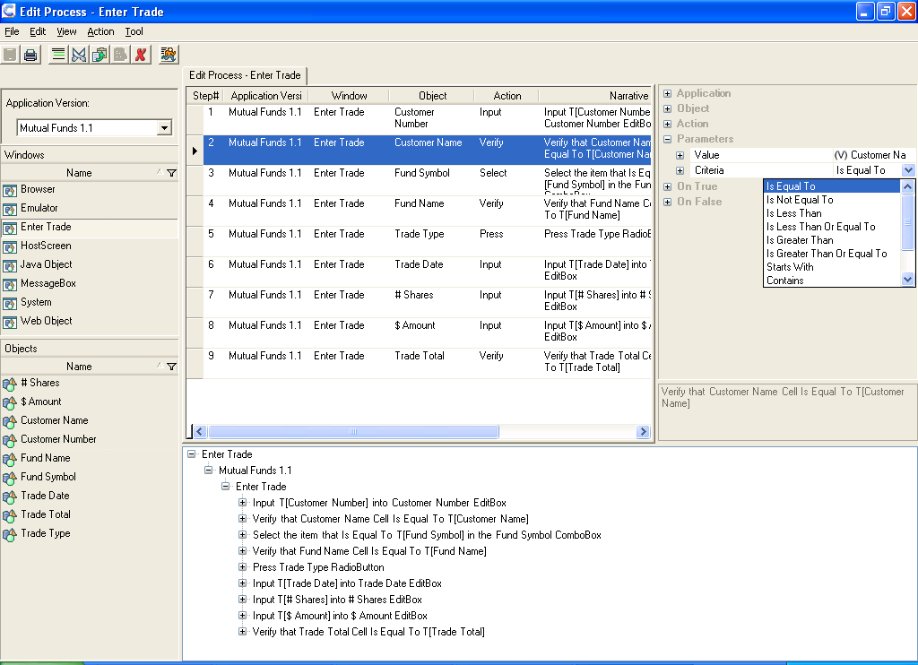
Provide Data

Slide 62
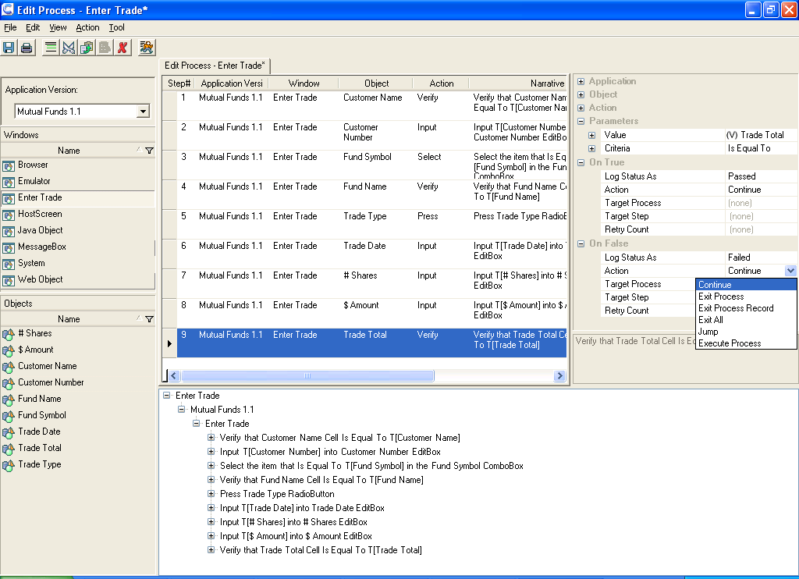
On Pass, On Fail

Slide 63
Software Developer
Design story(ies) implementation
  Architecture layers
  Code components
  Messaging/services
  Data schema(s)
  Integration points
  User interface
Construct code
  Develop or incorporate components
  Verify against map
  Verify against workflow
Unit test
  Verify using test data

Slide 64
Automation Engineer
Identify data control types
  Analyze software design
Create application map
  Analyze metadata
Create variables
  One per data element
Write workflow driver
  Execute steps
Write execution support
  Setup, context recovery, error and test logging

Slide 65
Identify Data Control Types
Edit Box
  User supplied alpha or numeric values
Combo Box
  User supplied or list selection
List
  User selected from pre-existing values
Radio Button
  User select from set of options
Static Text
  Displayed alpha or numeric values
Push Button
  Processing action

Slide 66
Define Application Map
Application inventory
  Context > Class > Object > Attributes
Vocabulary for tests
  Locate, act on objects
Links tests to application
  Supports maintenance
Create map
  Generate from metadata
  Develop manually

Slide 67

Window
Application component
  Web page
  Client/server window
  Mainframe screen
  Database table
  XML message
Defines user context
  Available objects
  Used for synchronization

Slide 68

Object
Application component
  Menu, Text Box, List, Radio Button, etc.
Class determines characteristics
  Methods and properties
Standard
  Defined by operating system
Custom
  Super/sub class or user defined
Recognition method
  Name, ID is ideal
  Ordinal, index not stable

Slide 69

Define Application Map
Combo Box
  Customer number
List Box
  Fund symbol
Exit Box
  # Shares
  $ Amount
Radio Button
  Trade Type
  Shares or dollars
Static Text
  Trade date
  Price per share
Button
  OK
  Cancel

Slide 70
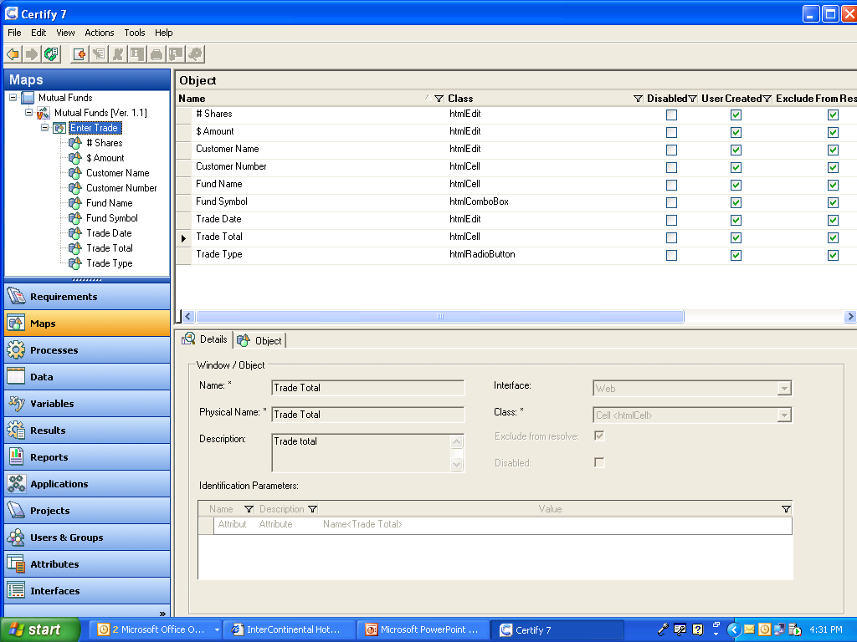
Database Application Map

Slide 71
Create Variables
One per data element
  Used to store test data values
  Distinguish from literal or constants (@ prefix)
Do not map to data type
  All text values
  Permits negative testing
    Provide alpha to numeric fields
    Exceed field length
Ideally map to data store
  Database of file column name
  UI control name

Slide 72
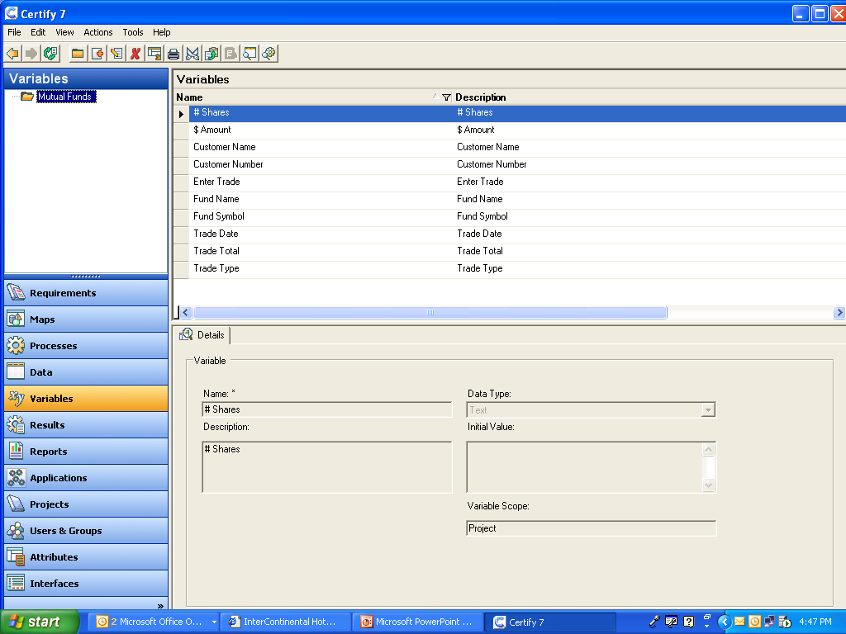
Create Variables

Slide 73

Write Workflow Driver
Reads test data
  Loops once per row of data
Reads workflow data
  Loops once per step row
Manages timing synchronization
  Assures application is ready
Verifies context
  Assures context is correct
  Assures object is available
Dispatches actions
  Calls related function

Slide 74
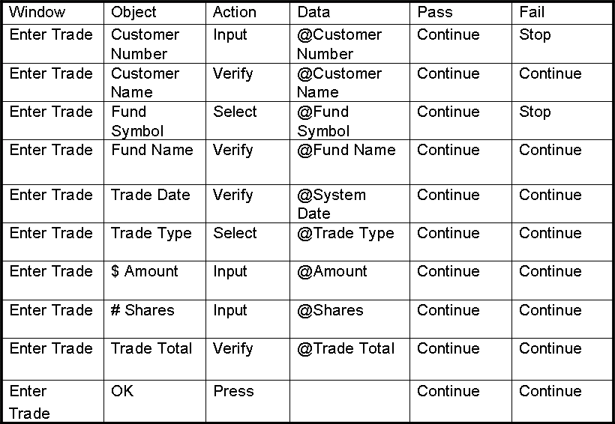
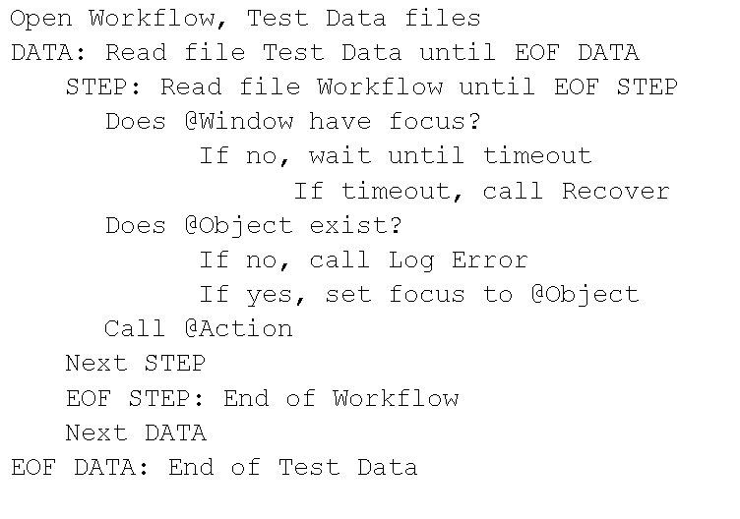
Sample Workflow Driver

Slide 75

Execute Tests
Create suites as needed
  Sequences of test workflows
  Manage dependencies
Prepare test environment
  Run Setup utility
  Verify environment
  Install software
Execute Tests
  Execute suites, workflows
Reporting
  Stories/requirements satisfied
  Missing or incomplete features
  Defects

Slide 76
Sample Suite File
Workflow
Logon
Create Customer
Create Fund
Enter Trade
Verify Confirmation
Verify Settlement
Verify Customer
Test Data
Users
Customers
Funds
Trades
Confirmations
Settlements
Customer Balances

Slide 77
Automated Execution
Execution log monitors results
  Step by step pass/fail
  Verify object naming conventions
  Verify classes, actions
  Verify data inputs, outputs
  Verify workflow
  Verify test cases
Rapid feedback
  Identify issues quickly
  Allow developers to execute automated tests
  Free up time to write next set of tests

Slide 78
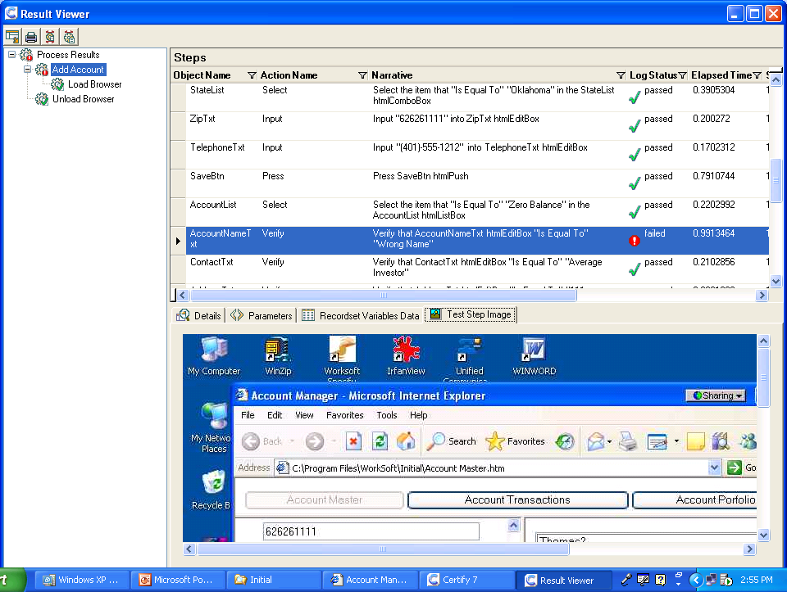
Results Log

Slide 79
Analyze Results
Test environment issue
  Incorrect platform configuration
  Incorrect data
  Interfaces not available
Errors in test workflow
  Missing steps
  Wrong order
Errors in test data
  Data values not correct
  Data not aligned with environment
Software defect
  Design or coding error

Slide 80
Second+ Iteration

Slide 81

Business Expert
Define additional stories
  Continue in priority order
Perform data analysis
  Add or extend test data
Triage reported defects
  Based on previous iteration
Review prior workflows for changes
  Based on new functionality
Convert new stories to workflows
  Follow same process
Add, update test data
  Changes, additions

Slide 82

Software Developer
Incremental design changes
  Likely UI additions
  May include data stores, services, interfaces
Remedy priority defects
  Based on business expert triage
Code new functionality
  May impact prior components
Execute regression tests
  Tests from prior iteration
Perform unit testing
  New or modified workflows, test data

Slide 83
Automation Engineer
Update application map
  New UI elements
  Changes to existing ones
Update variables
  Cover new data elements
Perform impact analysis
  Determine if changes affect existing workflows
Make global updates
  Remove deleted object references
  Update modified object properties
Notify business experts of additions
  May need to add to workflows, test data

Slide 84
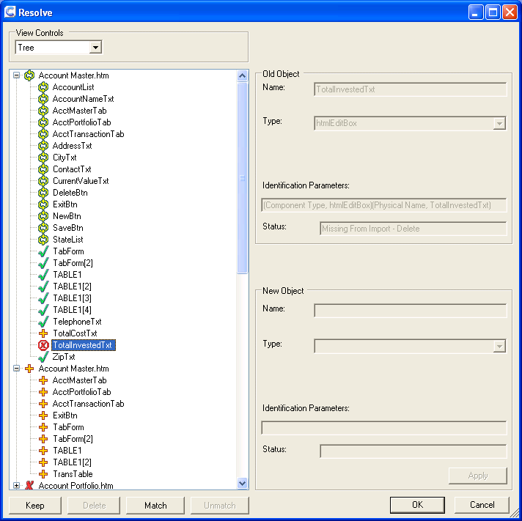
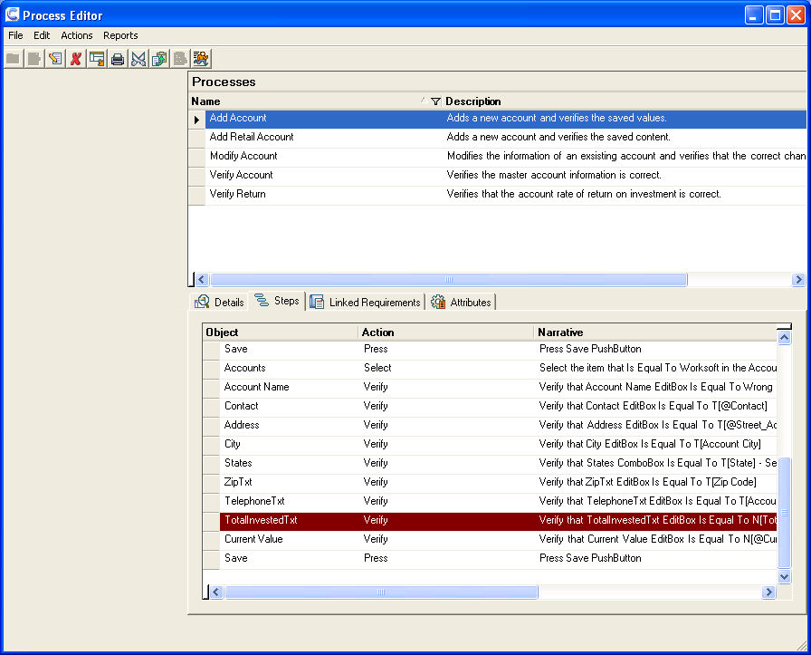
Impact Analysis, Updates

Slide 85



Benefits of Design…
Improve time to market
Maximize team skills
Improve coding practices
Ease of maintenance

Slide 86
Improve Time to Market
Prepare infrastructure in advance
  Be prepared to execute when code received
Verify automation compatibility
  Avoid time-consuming workarounds
Express requirements as test cases
  Provide workflows to guide developers
Provide data to development
  Support unit testing, debugging
Catch defects early
  Both regression and new functionality
Reduce rework
  Communicate expectations clearly

Slide 87
Maximize Team Skills
Empower business experts
  Write automated tests without coding
Leverage automation engineers
  Minimize coding effort
Assist developers
  Test cases, workflows guide design
Align all members
  Requirements as test cases

Slide 88
Deliver Better Quality
Reduce defects
  Test cases guide developers
Improve coding practices
  Consistent naming standards
Expanded test coverage
  Enable regression of past iterations
Efficient test cycles
  Automation speeds execution
Capture knowledge
  Support transfer for the future

Slide 89

Ease of Maintenance
Store test data separately from workflow
  Easy to expand coverage
Store test cases as data not code
  Instant impact analysis, global updates
Reusability keeps code volume to minimum
  Class/action code rarely changes
Coding standards stabilize map
  No need for constant corrections

Slide 90

Contact Information
Linda@worksoft.com
  Questions and answers
www.worksoft.com
  White papers
  Certify Demo
Columns
  www.stickyminds.com
  www.computerworld.com
  www.datamation.com

Slide 91

Contact Information
Available to attendees only
  www.worksoft.com/STP
    Must provide valid email
    No follow-up unless requested
Includes:
  Presentation slides
  Sample action code
  Automated Testing Handbook
  Quality is Everyone's Business
  Web demo
  White Paper - Test Automation Maturity Curve
  Free application testability assessment

